Slide 1
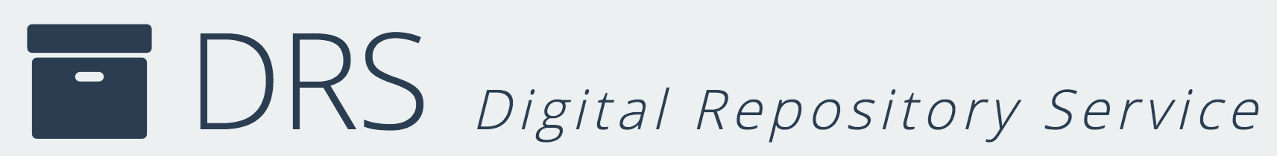
Digital Repositories
Gateways to Digital Stewardship
Sarah Sweeney
Digital Repository Manager
Northeastern University Libraries
repository.library.northeastern.edu
Notes:
Good afternoon everyone. My name is Sarah Sweeney and I am the Digital Repository Manager for Northeastern University Libraries. I am part of our library’s Digital Scholarship Group and I am going use my seven minutes to rave about the incredible opportunity we have when working with repository users to help them solve their digital asset storage problems to also teach them about good digital stewardship practices.
If you’re not talking about good digital stewardship practices with your repository users, I want to encourage you to think about what you can do to help strengthen your users’ stewardship skills and work towards the mutual goal of creating more robust and stable digital projects.

Slide 2
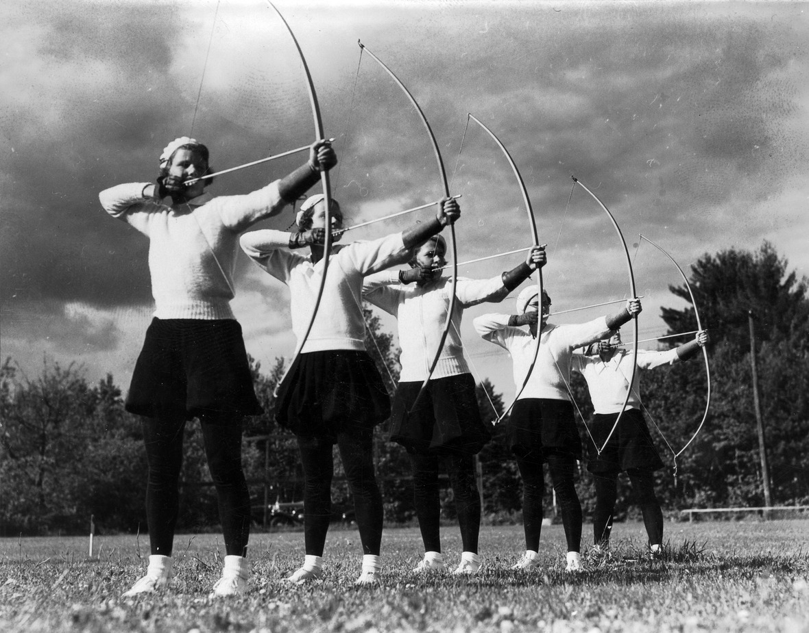
What is Digital Stewardship?
"Digital stewardship encompasses all activities related to the care and management of digital objects over time. Proper digital stewardship addresses all phases of the digital object lifecycle: from digital asset conception, creation, appraisal, description, and preservation, to accessibility, reuse, and beyond."
Archers from Boston-Bouve College. 1934. Northeastern University Library (Boston, Massachusetts), June 9, 2016. http://hdl.handle.net/2047/d20167889
Notes:
Digital stewardship, digital curation, and digital preservation are sometimes used interchangeably, correctly or incorrectly depending on the context. During her National Digital Stewardship Residency at the Folger Shakespeare Library, Jaime McCurry described digital stewardship as encompassing …. “all activities related to the care and management of digital objects over time. Proper digital stewardship addresses all phases of the digital object lifecycle: from digital asset conception, creation, appraisal, description, and preservation, to accessibility, reuse, and beyond.”
Similar to Jamie’s definition, for the purposes of this presentation I’m using the term digital stewardship to describe the practice of creating, storing, sharing, and protecting digital objects of any kind to ensure long-term usability.
For most repository users, digital preservation often means relying on others to provide the appropriate technical infrastructure, so I’m going to stop short of raving about inserting preservation practices into our discussions with users.

Slide 3
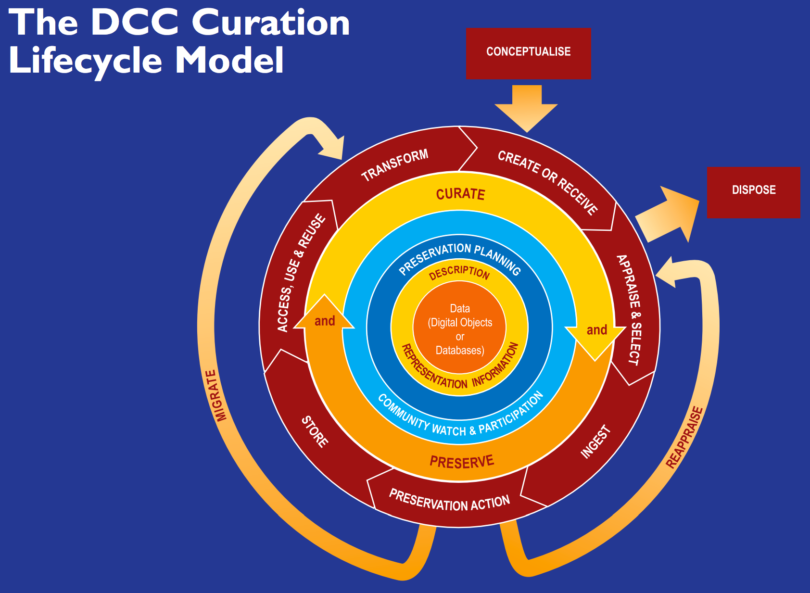
Digital Stewardship in Action
Plan
Collect
Describe
Maintain
DCC Curation Lifecycle Model. Digital Curation Centre. June 9, 2016. http://www.dcc.ac.uk/resources/curation-lifecycle-model
Notes:
Digital stewardship in action: The Digital Curation Centre nicely, and with some complexity, illustrates the lifecycle of digital materials using this handy “Journey to the Center of the Earth”-like diagram.
Using DCC’s illustration as a model, we can identify four basic stewardship and curation actions: plan, collect, describe, and maintain.
Before and as you create or collect digital materials, you should plan ahead for the management of those materials.
Whether you create or collect digital materials, you should do so methodically, creating or collecting metadata as you gather your materials.
You should create and store as much metadata as possible about your digital materials, including descriptive, administrative, technical, and preservation metadata, using appropriate standards, and applying metadata consistently, if possible. Make sure your digital materials are clearly identified, and the system you use to organize those materials can be used by others.
Be selective about the digital materials you collect. Carefully evaluate what materials require long-term maintenance and what can be weeded, and not just retained for retention’s sake.
Even though this model is complex, I think it’s important to note, as the DCC does, that digital curation can be employed in varying degrees, and we and our repository users don’t need to fully implement every best practice to be good caretakers of our digital materials. Digital stewardship and curation practices can be applied in any environment by anyone responsible for the well-being of digital materials.

Slide 4
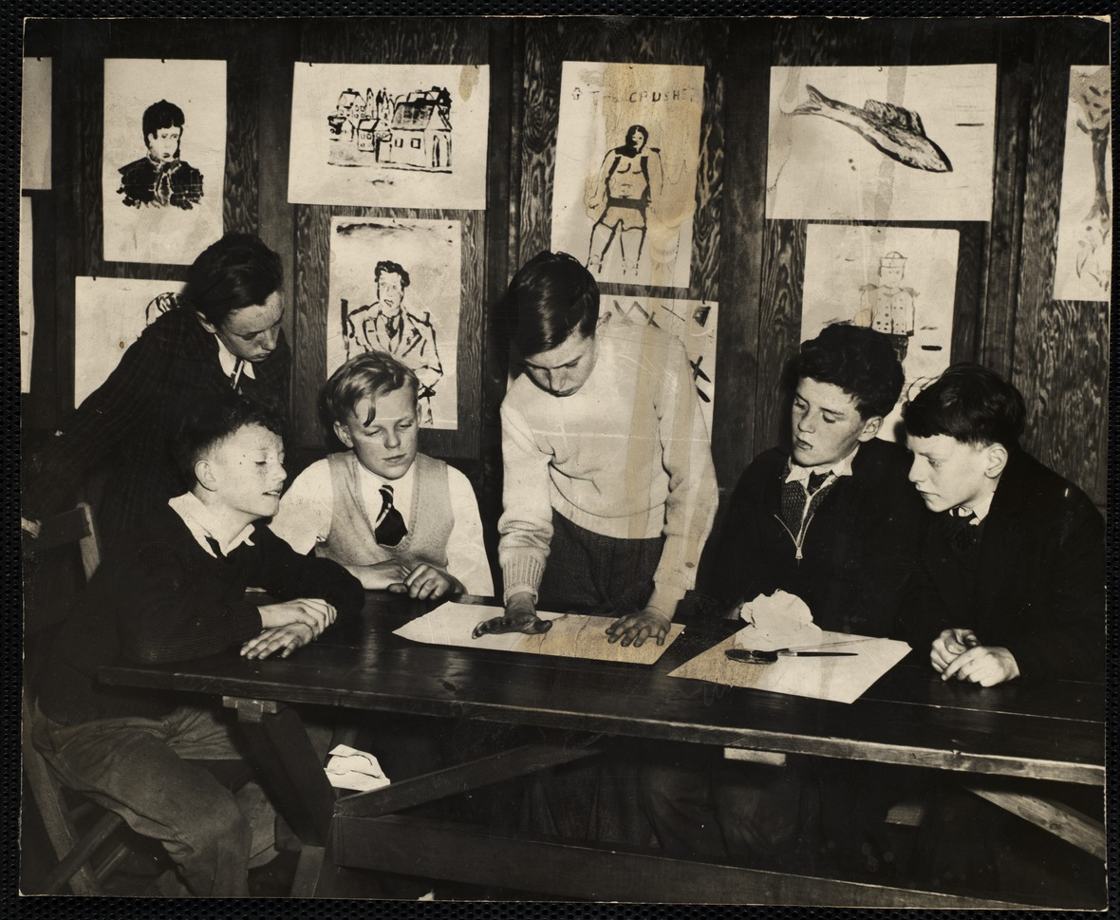
Stewarding
A boy working on a project for his art class while five others look on at the South Boston Boys' Club. ca. 1945. Northeastern University Library (Boston, Massachusetts), June 9, 2016. http://hdl.handle.net/2047/d20164399
Notes:
So what does it mean to be a steward of digital materials? A digital steward can be can be both an actor and a facilitator. As a repository manager, I spend most of my time as an actor, working to plan, collect, describe, and maintain digital materials on behalf of others. But I, and others in our Digital Scholarship Group, often act as facilitators of good digital stewardship practices.
In our library we encounter a lot of university staff and faculty with digital materials they need to store, use, and share. They often come to us with a problem: they have been struggling to manage some sort of digital project, from research data to departmental photography. The materials are precariously stored on an individual’s hard drive, they may have had a close call with losing materials, or they may have experienced staff turnover and want to make sure future staff changes don’t disrupt their project or digital materials.
Our working relationships with faculty, researchers, and project teams start because we offer them a solution to their problems: secure repository storage for their digital materials. As we build this relationship, we discuss all the benefits of using a repository to store and share their materials. The advantages usually outweigh the disadvantages and we work together to ingest their files and setup a workflow for their research group, office, or department.
As our working relationship develops and we work to ingest their materials and setup workflows, we also take to time to learn about their work and about their practices. We discuss the details of their work, their project needs, and the project’s history. We gather what we learn and use that knowledge to offer them assistance with their project however we can.

Slide 5
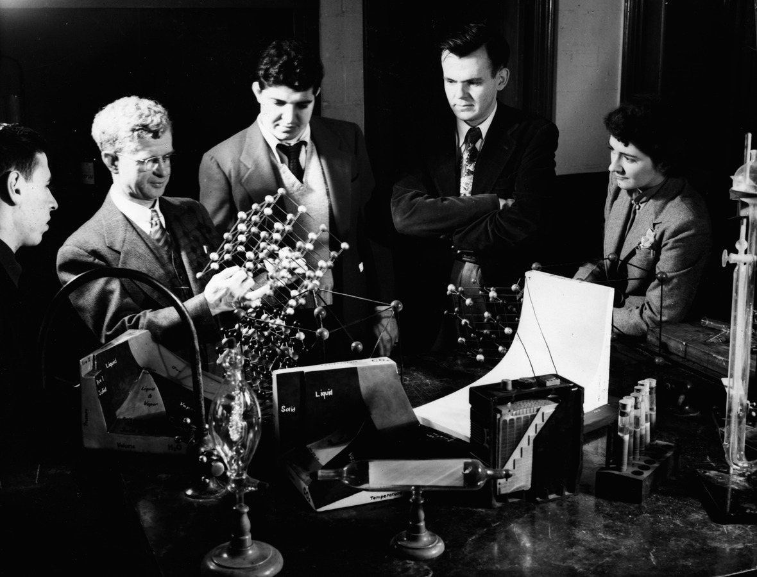
Facilitating Stewardship
Chemistry professor and students. ca. 1925. Northeastern University Library (Boston, Massachusetts), June 9, 2016. http://hdl.handle.net/2047/d20161246
Notes:
It’s at this point in the relationship we tend to move from actors to facilitators. As we learn about the elements of their project, we actively listen for how they plan to manage their digital materials. As the conversation evolves, we discuss what it means to use the repository as a digital storage tool, and we, sometimes without realizing it, pivot into what it means to care for and maintain digital materials. We learn about how they are collecting or creating their materials, and how those materials are currently stored. We learn about how they are organizing their materials, and, if they are generating metadata, how those objects are being described. We also learn about how they are managing all of their materials, all of which informs the digital stewardship discussion:
Your project is active and evolving? Let’s talk about version control.
Project files are disorganized and confusing? Let’s talk about documentation, codebooks, and file naming conventions.
Old files are obsolete? Let’s talk about open file types and migration.
We talk about how files will be used by their users and how providing detailed descriptive metadata can be used to increase discovery and access.
We talk about file access, use statements, and rights management.
We talk about long term management of their data and data management plans.
In these conversations we are using the repository and its workflows as a frame for digital stewardship concepts that otherwise seem tedious or overwhelming. The benefit of this is that we can encourage repository users to be stewards of their own digital materials without ever saying the words digital stewardship or digital curation.

Slide 6
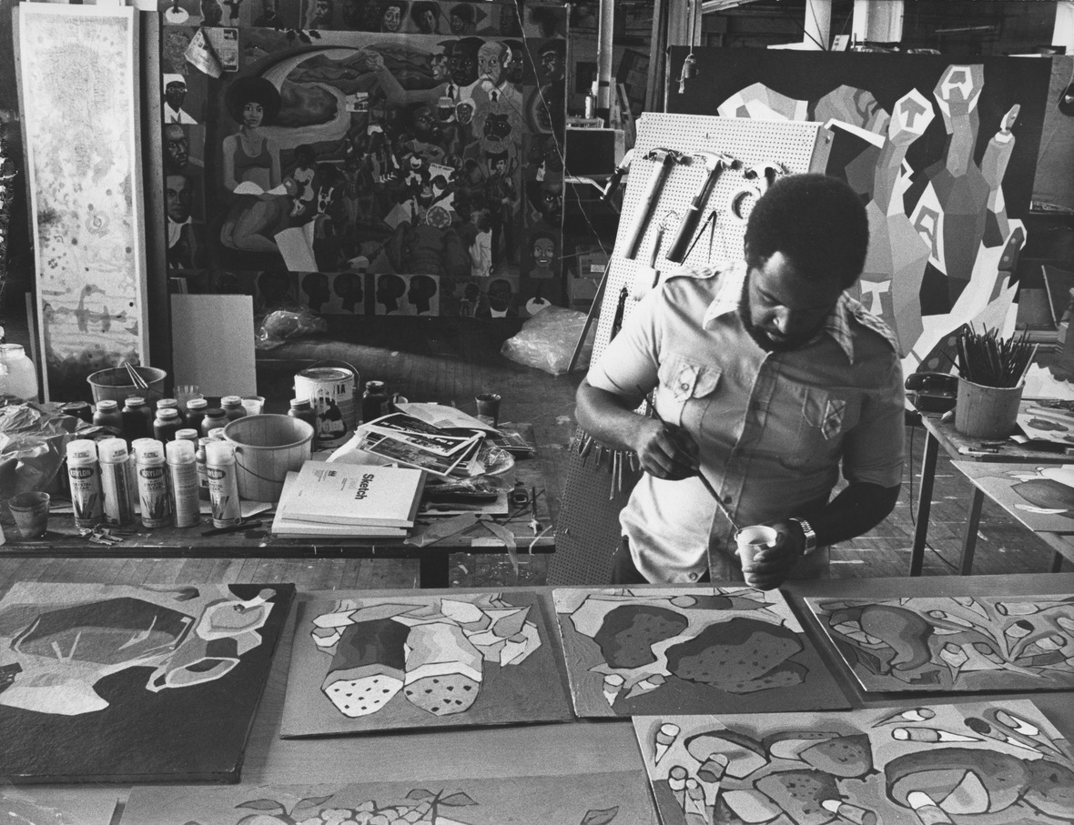
Encouraging Stewardship
Artist Dana Chandler painting in a studio. December 17, 1976. Northeastern University Library (Boston, Massachusetts), June 9, 2016. http://hdl.handle.net/2047/d20160915
Notes:
That’s not to say that we as repository staff have all the answers about digital stewardship; in fact, many of us are learning about best practices on the fly. Our library’s digital scholarship and repository staff rarely set out with a checklist of digital stewardship principles to discuss with our users. Rather, we take advantage of the opportunity we have when helping repository users to teach them about digital stewardship, while also attempting to make their lives easier.
By inserting these best practices into the discussions we are already having when we work with users, I think we have the opportunity to improve the quality of digital collections stored in our repositories and improve access to scholarly and cultural heritage collections.
I encourage you all to think about the relationships you have with stewards of digital materials, to listen to their experiences, and encourage them to insert digital stewardship best practices into their own work. Thank you.

Slide 7
Resources
DRS
DRS Resources
Contact
https://repository.library.northeastern.edu
http://library.northeastern.edu
sj.sweeney@neu.edu
Sarah Sweeney
Digital Repository Manager
Northeastern University Libraries
repository.library.northeastern.edu
Notes:
Promotional Slide

Slide 8
Citations
Archers from Boston-Bouve College. 1934. Northeastern University Library (Boston, Massachusetts). June 9, 2016, http://hdl.handle.net/2047/d20167889
A boy working on a project for his art class while five others look on at the South Boston Boys' Club. ca. 1945. Northeastern University Library (Boston, Massachusetts). June 9, 2016, http://hdl.handle.net/2047/d20164399
Chemistry professor and students. ca. 1925. Northeastern University Library (Boston, Massachusetts). June 9, 2016, http://hdl.handle.net/2047/d20161246
Cloonan, Michèle V, Martha R. Mahard. Collaborative Approaches to Teaching Digital Stewardship: Classroom, Laboratory, and Internships. Paper presented at IFLA-ALISE-EUCLID Conference, Cooperation and Collaboration in Teaching and Research: Trends in LIS Education, Borås, Sweden, August 8-9, 2010.
Digital Curation Centre. The DCC Curation Lifecycle Model. June 9, 2016, http://www.dcc.ac.uk/resources/curation-lifecycle-model
McCurry, Jaime. Digital Stewardship: The one with all the definitions. April 2, 2014. June 8, 2016, http://collation.folger.edu/2014/04/digital-stewardship-the-one-with-all-the-definitions
Schrader, Jerry. Artist Dana Chandler painting in a studio. December 17, 1976. Northeastern University Library (Boston, Massachusetts). June 9, 2016, http://hdl.handle.net/2047/d20160915

